Slide 1
SPAM OR NOT SPAM?
JONATHAN BRYCE, MATTHEW LANE, JENNIFER HE, TOMMY LAO

Slide 2
INTRODUCTION
Data Reconstruction
Statistical Analysis
Different Models and Methods
Our Best Model
Interesting facts

Slide 3
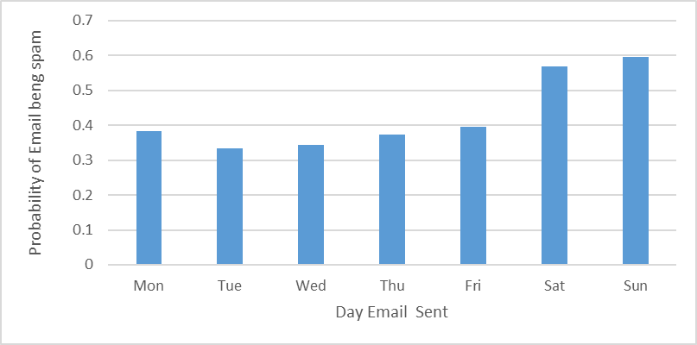
DATA RECONSTRUCTION
Figure 1: Relationship between day of the week and probability of spam

Slide 4
DATA RECONSTRUCTION
Days of the week
Weekends
Weekdays
Monday
Tuesday
Wednesday
Thursday
Friday
Saturday
Sunday

Slide 5
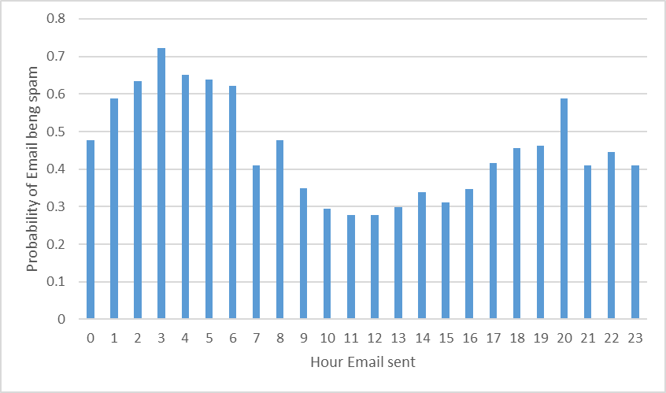
DATA RECONSTRUCTION
Figure 2: Relationship between hour of the day and the probability of spam

Slide 6
DATA RECONSTRUCTION
Hours
Work
Overnight
12AM-8AM
Evening
8AM-5PM
5pm-12am

Slide 7
DATA RECONSTRUCTION
Edu
com
Org
Other Domains
net

Slide 8
MODELS
Logit
Ensemble(combined)
SVM
Bayes
Random Forest

Slide 9
LOGISTIC MODEL
Accuracy: 85.8%
Used backward selection to select variables
Decision:
P(X) > 0.5 = spam
P(X) ≤ 0.5 = not spam

Slide 10
SVM MODEL
Accuracy: 85.8%
Grid search for Gamma and Cost
Used backward selection to select variables
Computation issues

Slide 11
BAYES MODEL
Accuracy: 86.6%
Common statistical technique of email filtering
Used backward selection to select variables
Variables
Standardized numeric variables

Slide 12
RANDOM FOREST
Used an M value of 52 out of 68 variables
Was tested using k-fold cross validation
Had the greatest test accuracy of all models tested

Slide 13
ENSEMBLE MODEL
A Bagged model based on the original data and a consensus of other models, consisting of
Was tested using k-fold cross validation
Had disappointing test accuracy
The random forest model
A boosted model
The logistic regression model

Slide 14
SELECTED MODEL: BAGGED/ENSEMBLE
Method | Initial Test Accuracy (%) | Final Test Accuracy (%) | Variables Used
Logistic | 81.6 | 85.8 | replyToSameAddress, weekend (dummy), percentLowerCase, numDigits, size, localSender, credit, pharm, sex, newsletter, edu, net, com and org.
SVM | 81.2 | 85.8 | percentLowerCase, numDigits, localSender, sucker,pharm, prescription, sell, discount, newsletter, Weekend, net, Night, replyToSameAddress
Bayes | 79.2 | 86.6 | replyToSameAddress, weekend (dummy), numDigits, Size, localSender, credit, pharm, sex, newsletter, edu, net, com, org and N/A domains
Random Forest | 90.6 | 91.1 | All variables used. Weekday, Hour and Domain variables were transformed into collections of binary variables
Ensemble | 86.5 | 91.9 | As above for random forest model

Slide 15
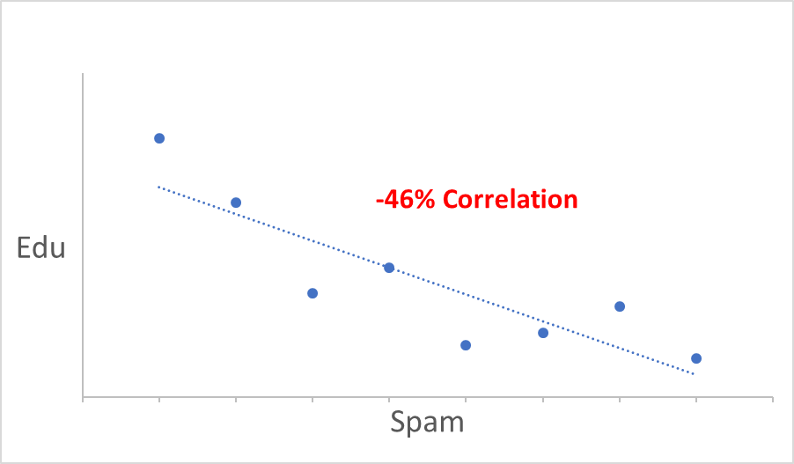
INTERESTING FINDINGS

Slide 16
INTERESTING FINDINGS
Edu
LocalSender
97% Correlation

Slide 17
INTERESTING FINDINGS
Statistically Insignificant
Porn
Spam

Slide 18

?QUESTIONS
This Photo by Unknown Author is licensed under CC BY

